Slide 1
User
System
Input Image
Request Caption
Yes
Trained Model Exists
No
Retrieve Trained Model
Train Model
Retrieve Trained Model
Generate Caption
Calculate Metrics
Display Caption

Slide 2
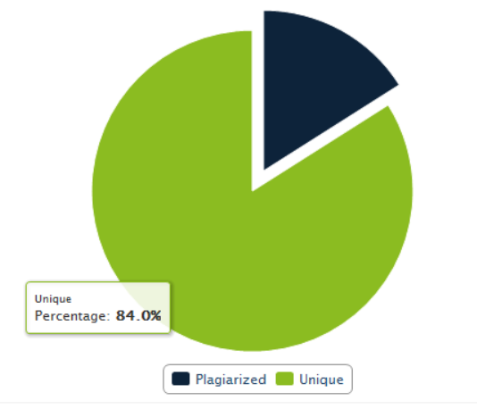
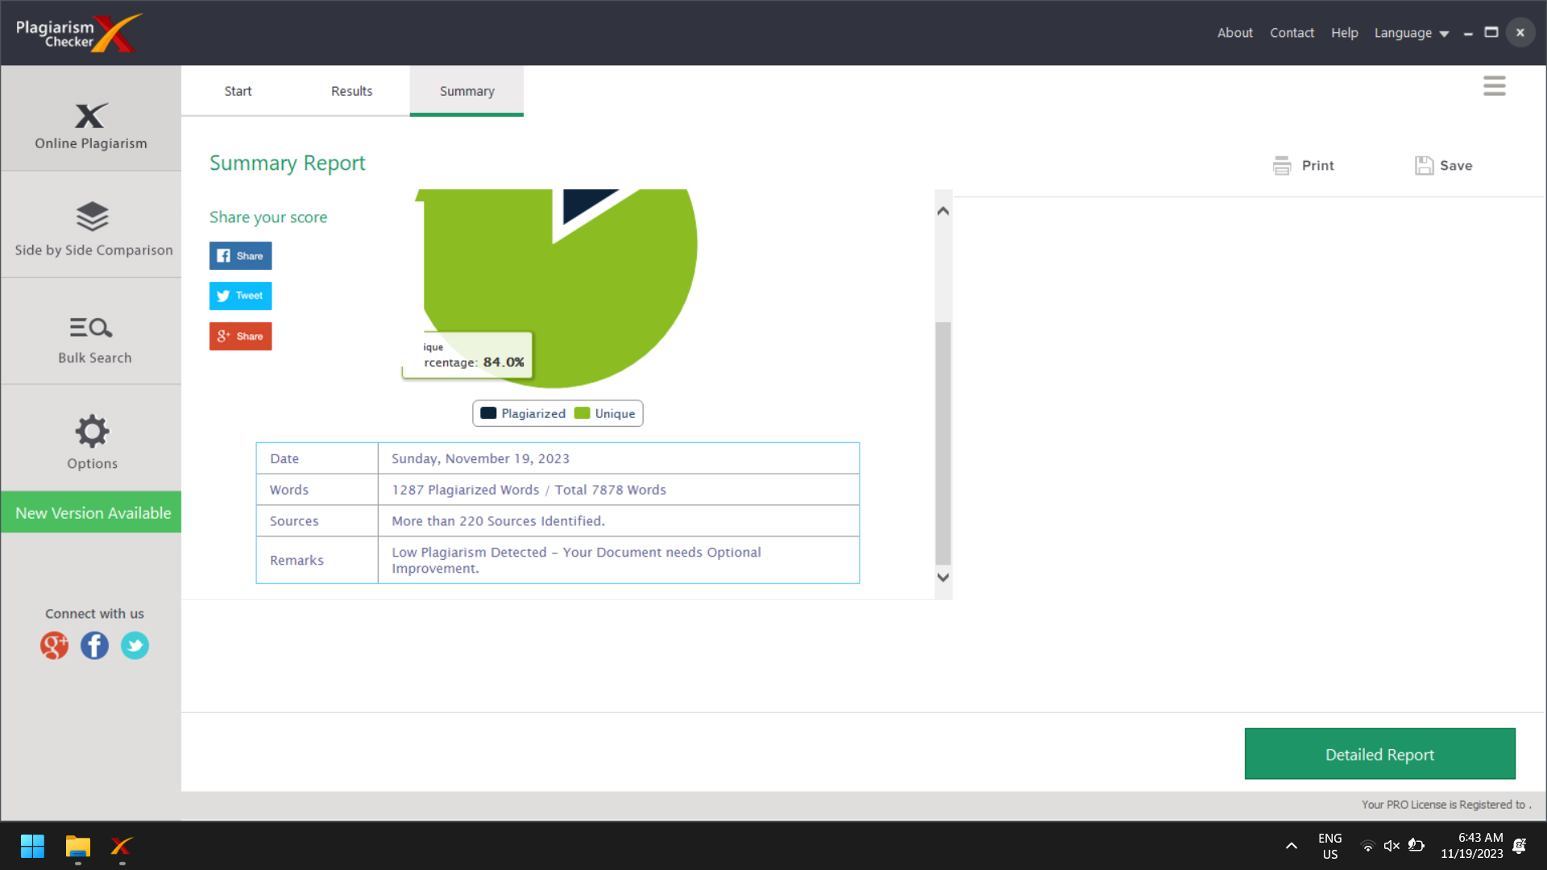

Slide 3
